Slide 1

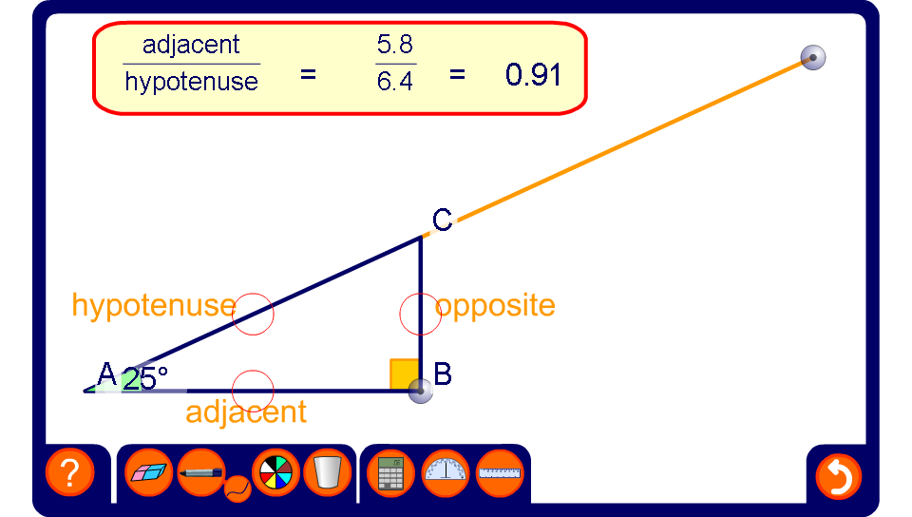


Similar right-angled triangles

